Slide 1

RAG(Retrieval Arugumented Generation)
Computer Science & Engineering
Jaya Prakash Narayan College Of Engineering
By
Elluri Kohitha

Slide 2

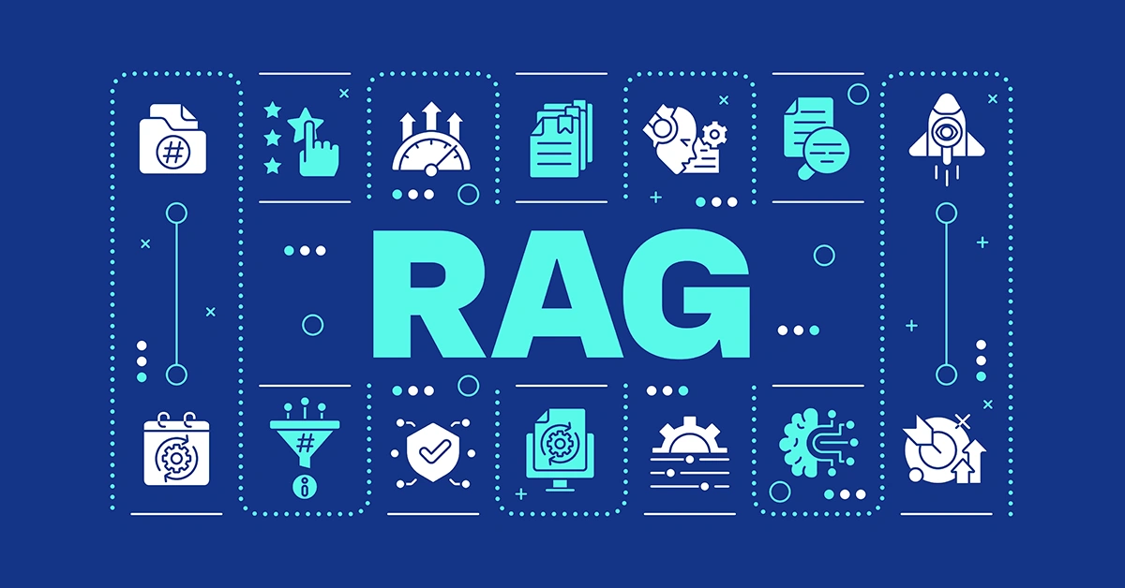
RAG (Retrieval-Augmented Generation) is an AI approach that combines a large language model (LLM) with an external knowledge source.
When the user asks a question, the RAG system searches a knowledge source (such as PDFs, documents, websites, or a database) to find the most relevant information before generating an answer.

Slide 3

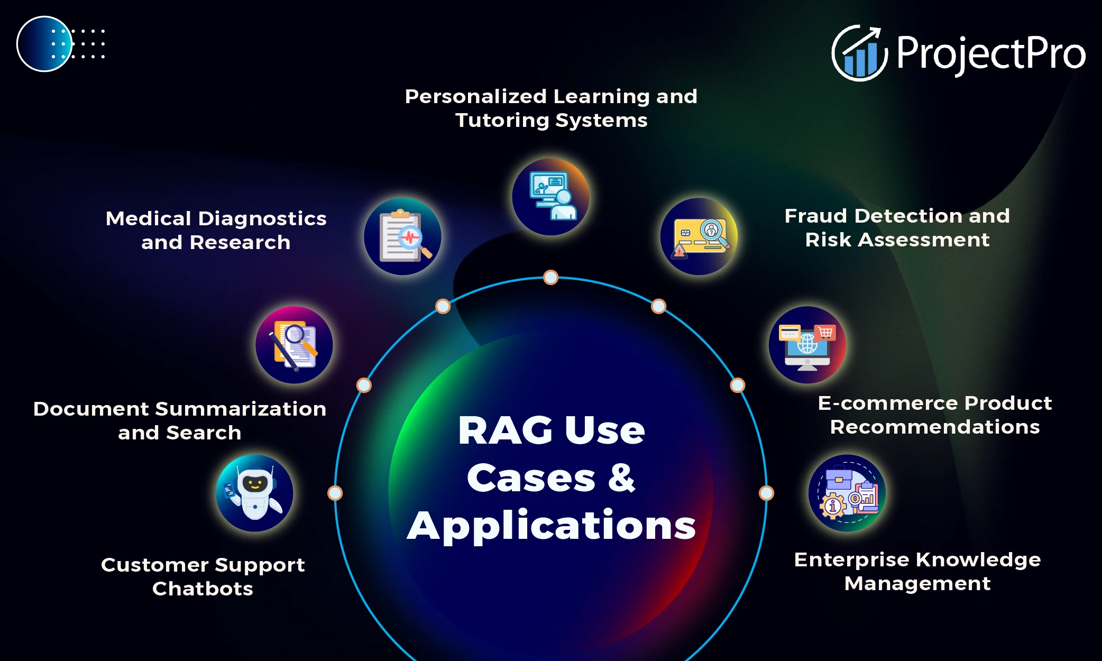

Slide 4

CUSTOMERS SUPPORT CHATBOTS
Instant Responses
Order Tracking
Issue Resolution
Ticket Creation
24/7 Customer Support

Slide 5
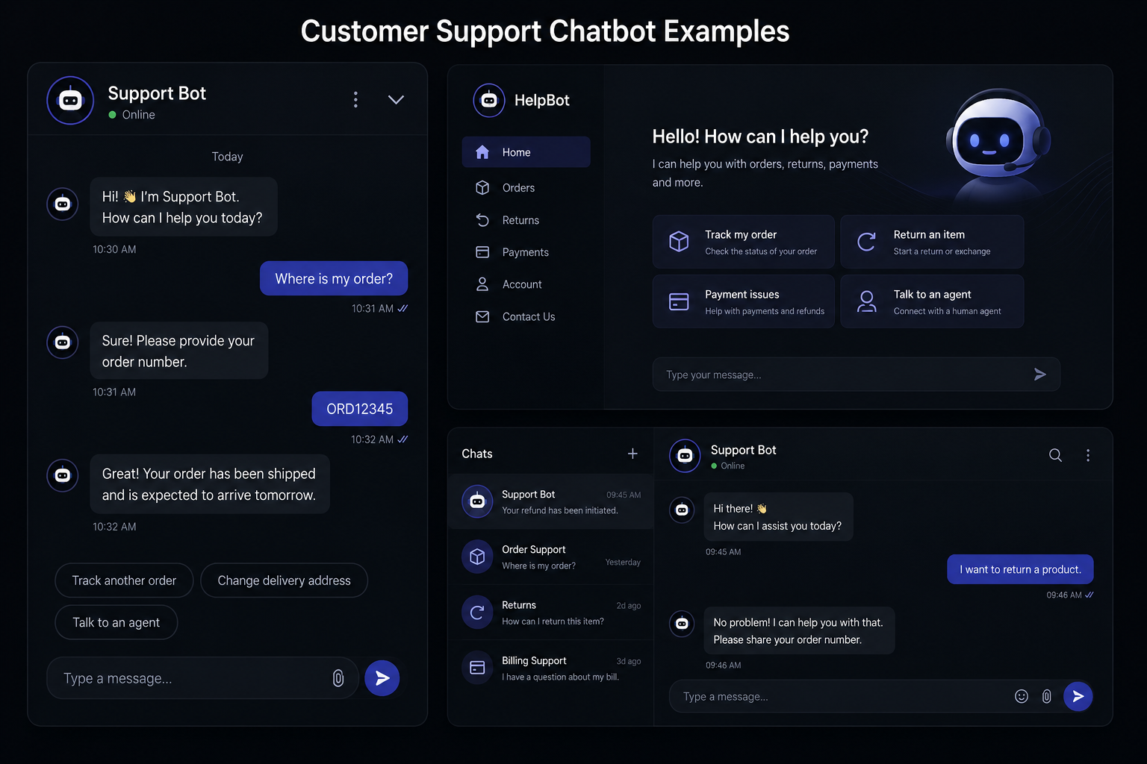

Slide 6
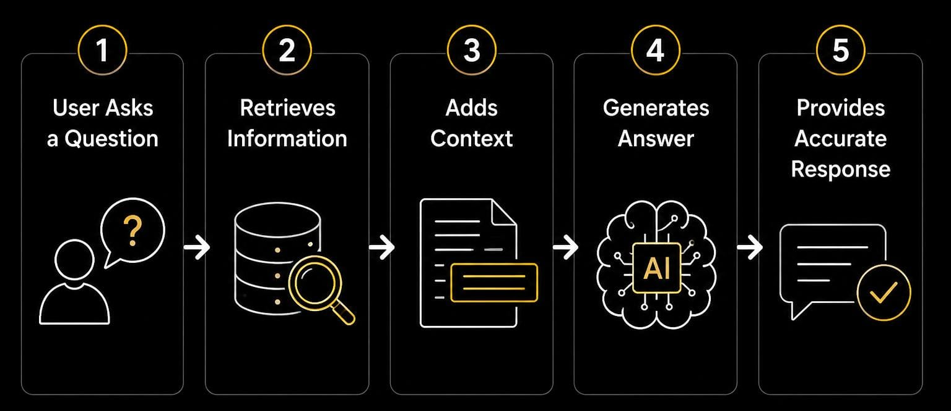
HOW RAG WORKS
First, the user asks a question. Then RAG searches for relevant information from its knowledge source. After that, the retrieved information is added as context. The AI model uses this context to generate the answer. Finally, it provides a more accurate and relevant response to the user.

Slide 7
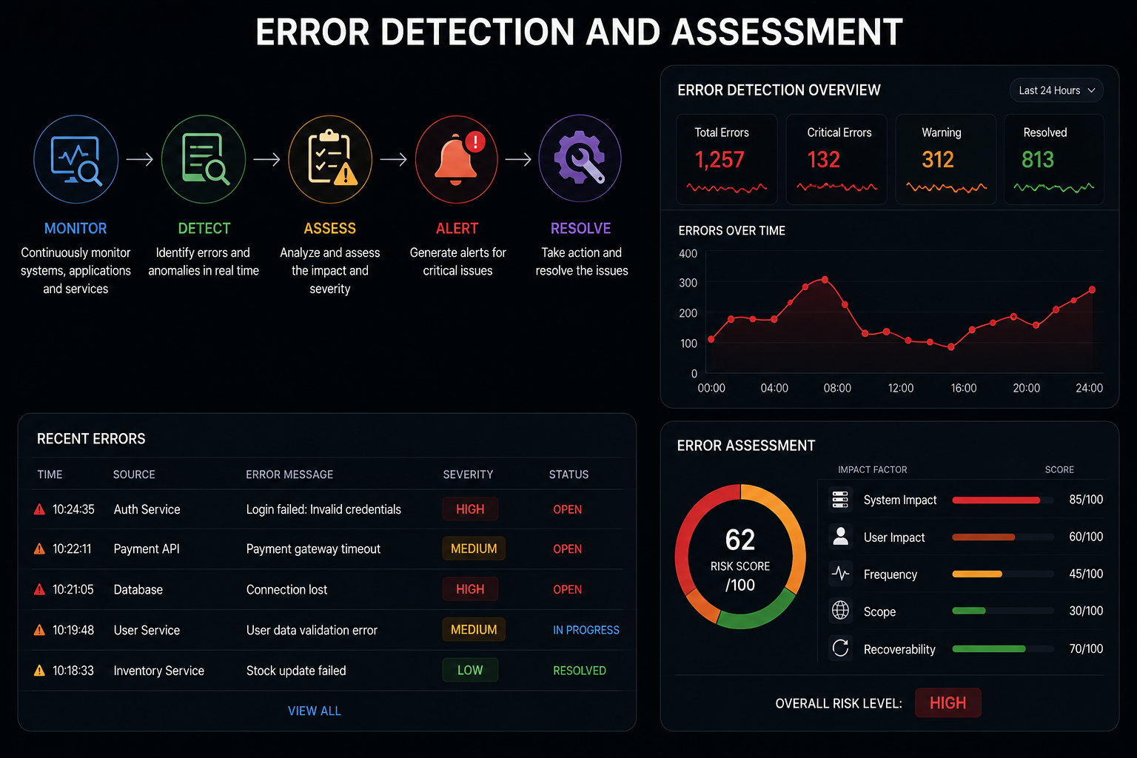
ERROR DECTECTION ASSESSMENT
Finds errors quickly
Checks system activities
Identifies unusual behavior
Measures error severity
Shows error alerts

Slide 8

Advantages
More Accurate Responses
Up-to-date information
Easy to update
Saves time and cost
Up-to-date information

Slide 9

Disadvantages
Depends on knowledge base
Slower responses
Needs good data
More complex
Security issues

Slide 10
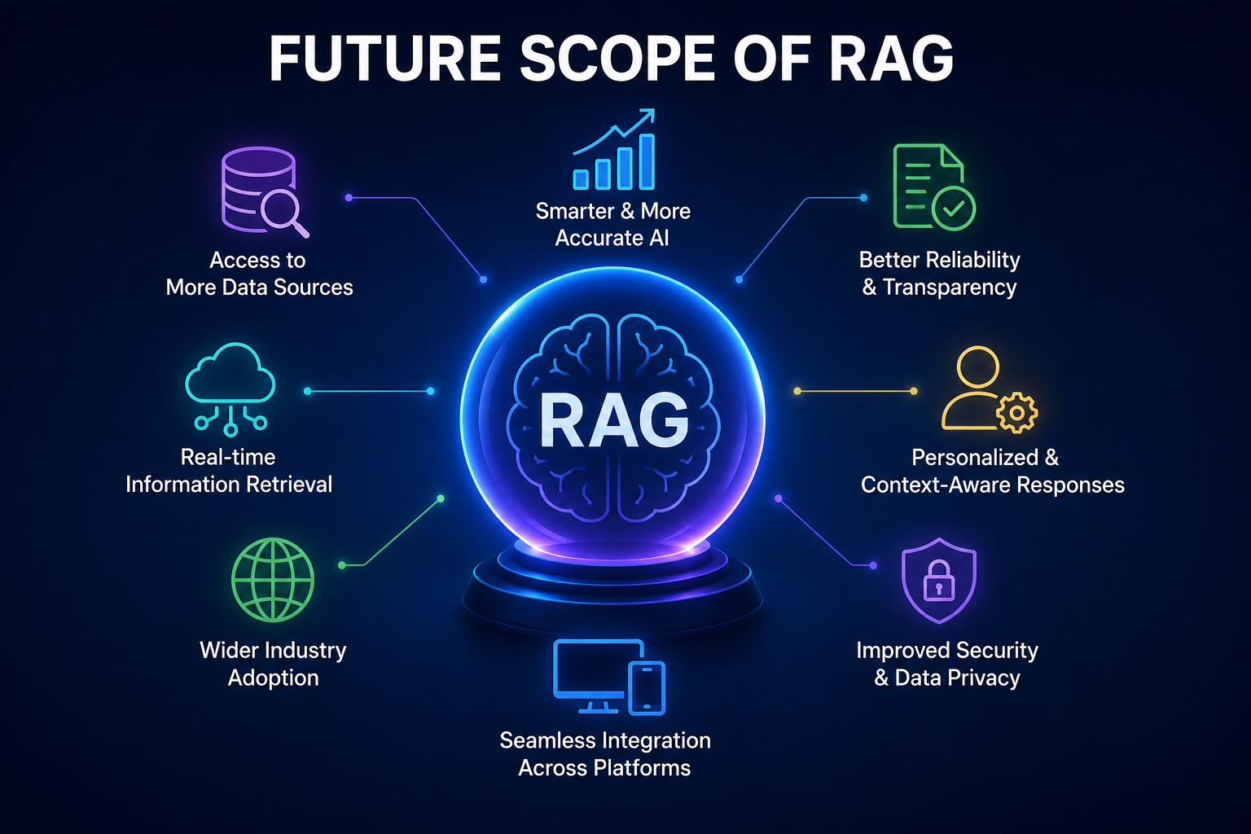
FUTURE SCOPE OF RAG
The future scope of RAG is very promising. RAG can provide more accurate and useful answers by using updated information from different sources. In the future, it can work with text, images, audio, and videos. It can also be used in areas like customer support, healthcare, education, finance, and business. RAG will help AI systems become smarter, more reliable, and more useful in everyday applications.

Slide 11
----“. The goal is to turn data into information, and information into insight.”
----Carly Fiorina

Slide 12



